Slide 1
Machine Learning
Unsupervised Learning in R
June 2019

Slide 2
Content
Unsupervised Learning in R
Welcome to the course!
Identify clustering problems
Introduction to k-means clustering
k-means clustering
Results of kmeans()
Visualizing and interpreting results of kmeans()
How kmeans() works and practical matters
Handling random algorithms
Selecting number of clusters
Introduction to the Pokemon data
Practical matters: working with real data
Review of k-means clustering
Hierarchical Clustering
Introduction to hierarchical clustering
Hierarchical clustering with results
Selecting number of clusters
Interpreting dendrogram
Cutting the tree
Clustering linkage and practical matters
Linkage methods
Comparing linkage methods
Practical matters: scaling
Comparing kmeans() and hclust()
Review of hierarchical clustering
Dimensionality Reduction with PCA
Introduction to PCA
PCA using prcomp()
Results of PCA
Additional results of PCA
Visualizing and interpreting PCA results
Interpreting biplots(1)
Interpreting biplots(2)
Variance explained
Visualize variance explained
Practical issues with PCA
Practical issues: scaling
Additional uses of PCA and wrap-up
Putting It All Together with a Case Study
Introduction to the case study
Preparing the data
Exploratory data analysis
Performing PCA
Interpreting PCA results
Variance explained
Communicating PCA results
PCA review and next steps
Hierarchical clustering of case data
Results of hierarchical clustering
Selecting number of clusters
k-means clustering and comparing results
Cluster on PCA results
Wrap-up and review

Slide 3
Discussion
Many times in ML, the goals is to find patterns in data without trying to make predictions – this is referred to as unsupervised learning. More specifically, this course focuses on clustering and dimensionality reduction.
There are two primary goals of unsupervised learning:
Find homogenous subgroups within larger group
Find patterns in the features of the data (dimensionality reduction is one way to do this)
There are three primary goals of dimensionality reduction:
Find patters in the features of the data
Visualization of high dimensional data
Pre-processing before supervised learning
Challenges and benefits of unsupervised learning:
No signle goal of the analysis
Requires more creativity
Much more unlabeled data available than cleanly labels data

Slide 4
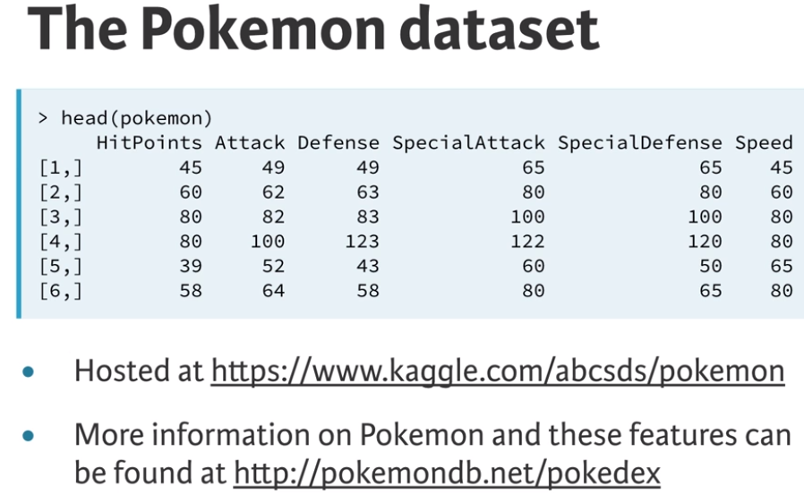
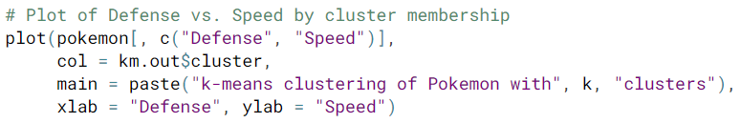
km.out <- kmeans(x, centers = 3, nstart = 20)
summary(km.out)
print(km.out$cluster)
print(km.out)
plot(x, col = km.out$cluster,
main = “k-means with 3 clusters,
xlab = “”, ylab = “”)
par(mfrow = c(2, 3))
set.set(1)
for (i in 1:6) {
km.out <- kmeans(x, centers = 3, start = 1, iter.max = 50)
plot(x, col = km.out$cluster,
main = km.out$tot.withinss,
xlab = “”, ylab = “”)
}
wss <- 0
for (i in 1:15) {
km.out <- kmeans(x, centers = i, nstart = 20)
wss[i] <- km.out$tot.withinss
}
plot(1:15, wss, type = “b”,
xlab = “Number of Clusters”,
ylab = “Within groups sum of squares”)
Model Selection
k-means has a random component
best outcome is based on total within cluster sum of squares
If you don’t know the number of clusters in advance and need to determine it, you’ll have to run the algorithm multiple times with differing number of clusters. From these iterations, you can observe how model quality changes with the number of clusters. A scree plot is used for this purpose.
sum of the squared (Euclidean) distance for each observation with each cluster
best outcome is the minimum of this metric
available components
cluster, centers, totss, withinss, tot.withinss
betweenss, size, iter, ifault
Data Challenges
Selecting the variables to cluster upon
Scaling the data
Determining the number of clusters
Visualize the results for interpretation
Unsupervised Learning in R

Slide 5
In hierarchical clustering, the first step is to determine the similarity between observations by using the dist() function.
hclust.out <- hclust(dist(x))
summary(hclust.out)
cutree(hclust.out, h = 7)
cutree(hclust.out, k = 3)
hclust.complete <- hclust(dist(x), method = “complete”)
hclust.average <- hclust(dist(x), method = “average”)
hclust.single <- hclust(dist(x), method = “single”)
colMeans(pokemon)
apply(pokemon, 2, sd)
pokemon.scaled <- scale(pokemon)
hclust.pokemon <- hclust(dist(pokemon.scaled), method = “complete”)
cut.pokemon <- cutree(hclust.pokemon, k = 3)
Compare → km.pokemon$cluster to cut.pokemon
cuts the dendrogram at a height of 7
cuts the dendrogram at a height at which 3 clusters form
The choice of linkage method can result in balanced (even number of observations assigned to each cluster) or unbalanced trees. The nature of the tree that is desired depends on the context of the problem you’re trying to solve. Unbalanced trees are desirable when outlier detection is important because pruning an unbalanced tree can result in most observations assigned to one cluster and only a few observations assigned to other clusters.
cluster linkage methods
Hierarchical Clustering

Slide 6
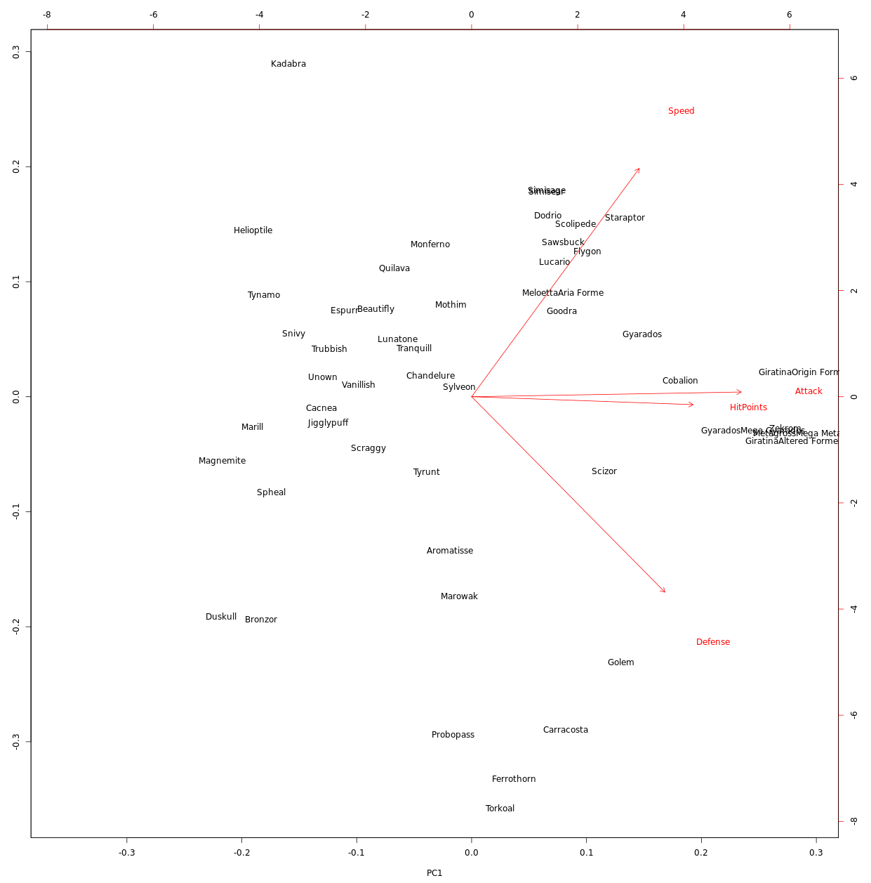
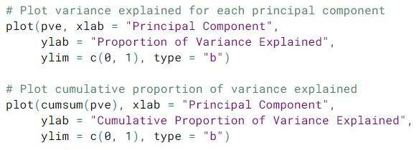
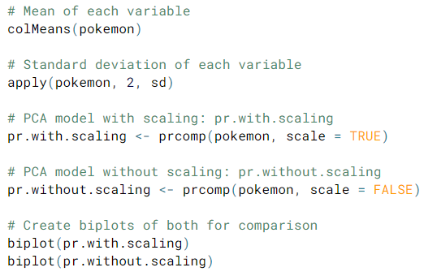
Dimensionality Reduction has two main goals – (1) find structure in features and (2) aid in visualization.
Principal Component Analysis (PCA) is a popular method for dimensionality reduction with three main goals – (1) find linear combination of variables to create principal components, (2) maintain the most variance in the data, and (3) derive uncorrelated (orthogonal) principal components.
pr.out <- prcomp(pokemon, scale = TRUE)
summary(pr.out)
PCA models in R produce additional diagnostics and output components:
center, scale, rotation, and x
Each of these components can be accessed using $ <- pr.out$rotation
biplot(pr.out)
pr.var <- pr.out$sdev ^ 2
pve <- pr.var / sum(pr.var)
Dimensionality Reduction with PCA

Slide 7
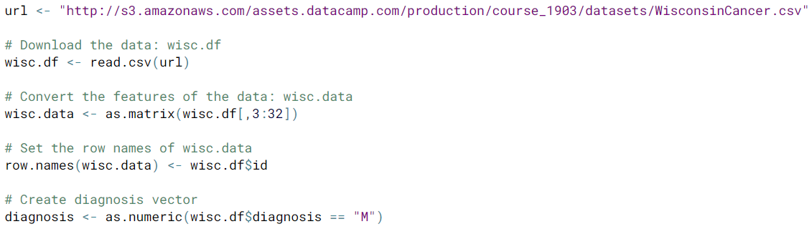
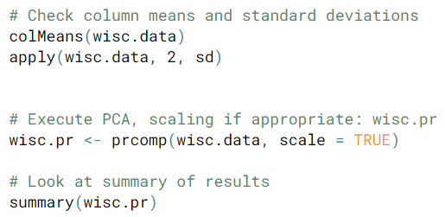
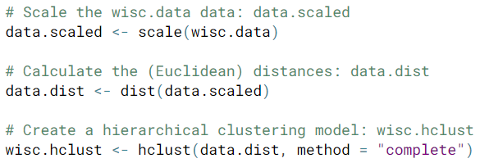
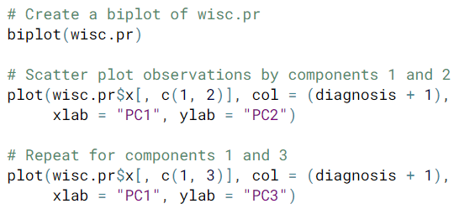
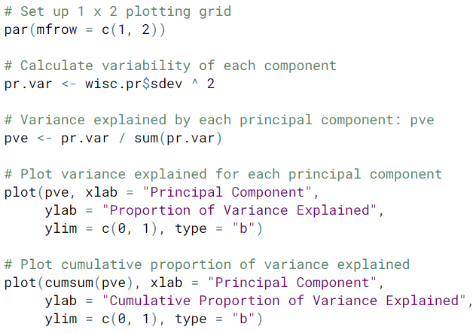
Overall Steps
Download data and prepare data for modeling
Exploratory data analysis
Perform PCA and interpret results
Complete two types of clustering
Understand and compare the two types
Combine PCA and clustering
Putting It All Together with a Case Study

Slide 8
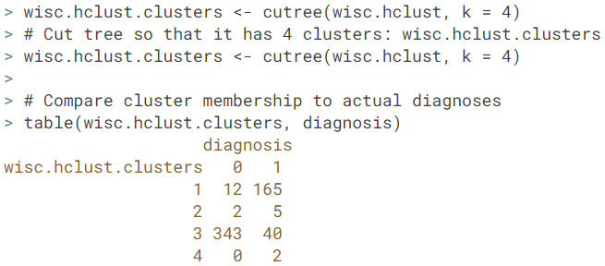
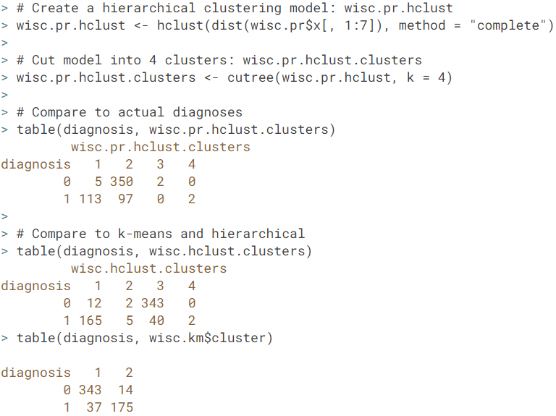
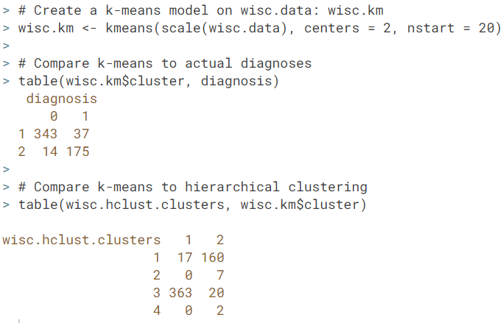
When a target variable (label) is available, you can compare the outputs from your hierarchical clustering model to observation labels in order to check the performance of the clustering model. When performning supervised learning – that is, when you’re trying to predict some target variable of interest and that target variable is available in the original data – using clustering to create new features may or may not improve the performance of the final model.

